Slide 1
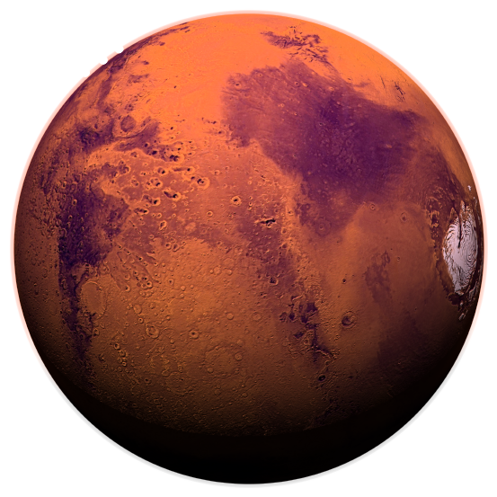
Mars In-Situ Resource Utilization
for Health Applications
Santana Solomon, Hikaru Furukawa, Dr. Sara Walker
Arizona State University
Arizona NASA Space Grant Consortium Symposium
17 April 2021

Slide 2
Introduction.
Central Question:
Are there chemical resources in space environments that can be used to aid human health during space missions?
Searching for chemical resources on Mars that could be used for human health applications (nutrition, vitamins, etc.)

Slide 3
Objectives.
Develop an integrated database of chemical compounds available in-situ in the Martian environment
Exploring possible biochemistries that can be produced on Mars with a network expansion
Connecting possible chemical networks on Mars to human health and sustainability

Slide 4
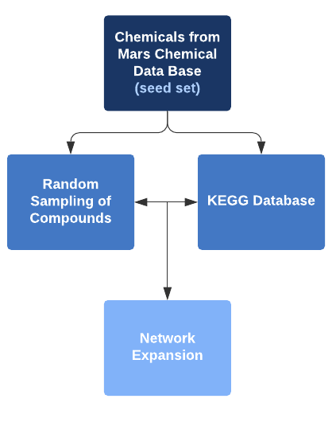
Methods.
Literature review to create chemical database (~25 papers)
KEGG Database used to associate chemicals with biochemical reactions
Perform network expansion + compare results with list of biochemicals necessary for human nutrition and health

Slide 5
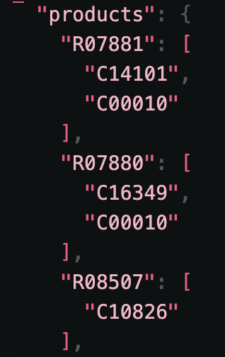
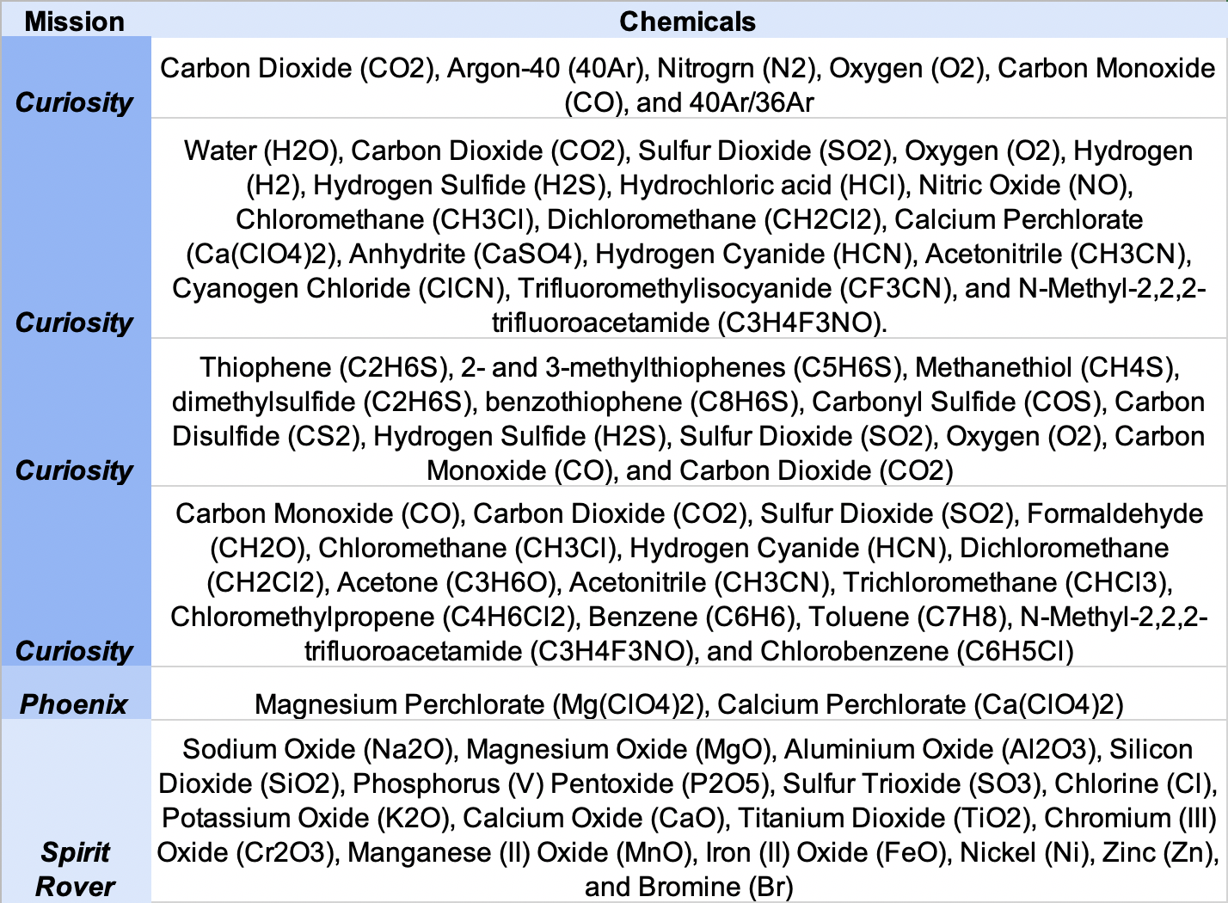
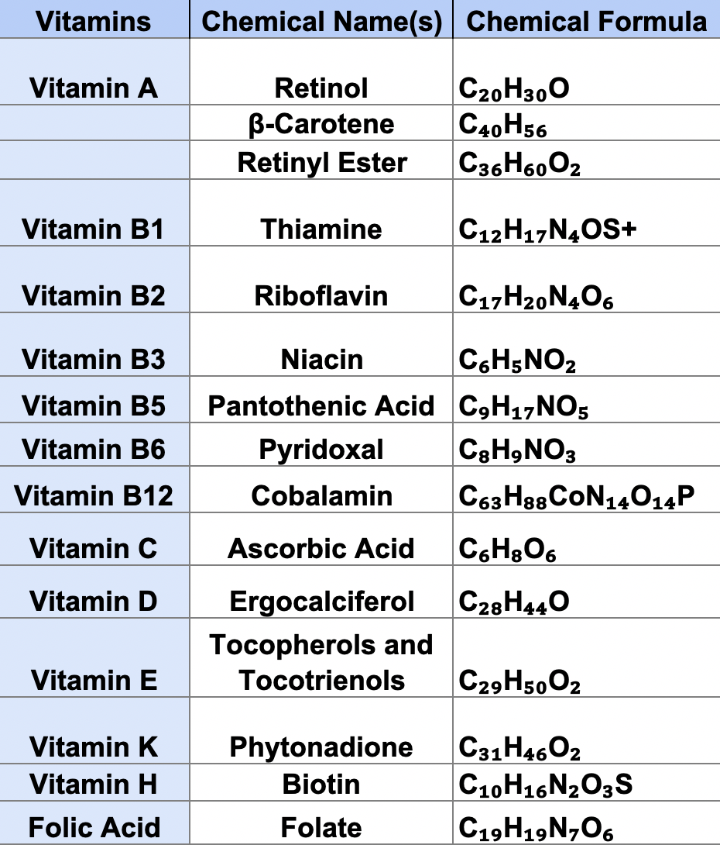
Results.

Slide 6
Future Directions.
Finish inputting chemical seeds into network expansion code from KEGG database
Sort chemical seeds
Create a Reaxys network expansion code
Explore use of planetary chemistry for in-situ microbiology and pharmacology

Slide 7
Acknowledgements.
Thank you to:
Dr. Sara Walker
Hikaru Furukawa
John Malloy
Alexa Drew
ASU Emergence Lab
ASU/NASA Space Grant
ASU School of Earth and Space Exploration
ASU College of Health Solutions

Slide 8
Thank you!

